Slide 1
Medication Administration
December 2022 Update

Slide 2
Course Objectives
To provide caregivers without a nursing or medical license, the knowledge to be able to safely and competently give medications to a person they are caring for
To provide caregivers a basic understanding about medications including classifications, names, storage and proper handling of medications
To provide caregivers an understanding of how to protect the privacy of the people they are caring for
The help caregivers understand when to ask for help and when to report problems

Slide 3
What to know, Part 1
Why is a medication being used?
What is the intended effect?
What are the likely unintended side effects?
Is the medication compatible with other medications being taken (medication interactions)?
Categories of medications
Families of medications
Names of medications
Proper medication storage

Slide 4
What to know, Part 2
How to give (administer) medications
How to record the medications given (documentation)
Alaska Assisted Living Homes Resident Bill of Rights
What to do when mistakes are made (medication errors)
How to protect privacy (confidentiality)

Slide 5
Competency Required
To ensure safety in administering medicines, all caregivers should be competent in the following areas:
  Medication Administration
  Maintaining accurate medication records
  The safe storage of all medications
  Knowing who to call if there are questions or concerns

Slide 6
Why medications are given
How medications work
Categories of medications
Names of medications
Proper storage of medications
How to give medications (administration)
Recording given medications (documentation)
What to do when mistakes are made (medication errors)
How to protect privacy (confidentiality)
Topics you will know (content)

Slide 7

Why medications are given
The human body does not always function perfectly
Medications are given in hopes of improving function

Slide 8
How medications work
Expected or desired effects
Correct medication levels
Factors that affect medication levels
Taking medications with or without food
Side effects of medications
  Minor
  Severe
  How to respond
Interactions with other medications
Toxicity

Slide 9
Expected or desired effects:
Prevent, Eliminate, Reduce, or Replace
Preventing illness
  Polio and Tetanus vaccines PREVENT illness
Eliminate a disease
  Antibiotics such as penicillin, ELIMINATE infections
Reduce symptoms related to illness or injuries
  Cold remedies REDUCE symptoms
Replace something the body is lacking
  Insulin provides fuel (glucose) control
  Thyroid controls temperature, growth, etc.

Slide 10
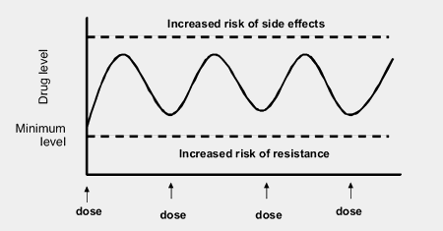
Correct (therapeutic) levels
Medications provide the desired effect only at certain levels in the blood
If the medication level is too high, harm can occur
If the level is too low, the medication is not effective

Slide 11
Medications need to be given as ordered
Studies have shown the timing for when a medication should be given to obtain/maintain a helpful (therapeutic) level in the body.
If medication is not given on time, the level may be too low or too high and can be dangerous
Examples:
  people with seizure disorders may have seizures if their medications are not given on time
  People with diabetes can have blood sugar levels too high or low if insulin is given at the wrong time

Slide 12
How do medications give the desired effects?
Most medications need to be absorbed in the body to take effect
Medications are absorbed by many parts of the body:
  Skin (topical)
  Lungs (inhaled)
  Digestive system (swallowed, under tongue, rectum)

Slide 13
Factors that affect medication levels
Many factors change how well a medication is absorbed for a particular person:
  Age Body weight/size
  Sex Pregnancy & breastfeeding
  Genetic factors Psychological factors
  Illnesses Allergies
Always be aware of the person’s response to a medication and always report ANY changes in their condition.

Slide 14
Factors: younger people
Children differ from adults in how they take in and process drugs in several ways:
  In infants, many systems are not fully developed to handle medications
  Blood-brain barrier isn’t fully developed
  The liver isn’t fully developed, so they cannot break down medications as effectively
  Kidneys are immature so medications are excreted slowly
  Children typically have higher concentrations of body water and lower concentrations of body fat

Slide 15
Factors: older people
Age: as a person ages…
  Absorption:
        Decreased acid in the stomach
        Decreased absorption in intestines
  Distribution in the Body:
        Decreased circulation
        Decreased water in cells
        Decreased protein in the blood
        Increased body fat

Slide 16
Factors: older people (cont)
Additional Factors for older adults
  Metabolism (breaking down):
        Decreased blood flow & fewer liver cells
        Decreased ability of liver to break down medications
        A dose a person has taken for many years may become harmful when it builds up
  Excretion (removing) by liver and kidneys:
        Kidney cells do not function as well
        Decreased blood flow
        So…medications are removed from the body at a slower rate

Slide 17
Factors: Genetics and Illness
Because of genetics, diseases, or injuries a person who is one age may have a body that responds like someone older or younger
Diseases of the stomach, intestines, kidneys, liver & circulatory system will affect medication levels in the body due to changes in absorption, metabolism, and excretion
A person with heart, kidney, or liver disease may respond like someone older. For example, a 35-year-old with kidney disease may process medications as if they were 70 years old.

Slide 18
Factors: physical abilities, size, sex
Is the patient able to swallow the medication as prescribed?
Is the patient vomiting so they cannot keep meds in their system long enough for absorption?
The larger the person, the more body tissue there is and may affect how much medication they need.
Sex differences between men & women (hormones, body fat, muscle mass, fluids) affect how meds are absorbed and used in the body.

Slide 19
Factors: Pregnancy & Breastfeeding
Pregnancy & Breastfeeding
  Medications taken by a pregnant woman can cross the placenta and affect the developing fetus. Some medications are harmful to a baby before it is born.
  Medications taken by a breastfeeding mother can be in the breast milk and absorbed by a baby.
Make sure the patient’s healthcare provider knows the patient is pregnant or breastfeeding.

Slide 20
Factors: genetics and psychological
Genetic Factors
  People who have Down syndrome age prematurely. A 40-year-old has a body that acts like a 60-year-old.
  Some genetic factors cannot be seen on the outside because they determine how cells on the inside process medications.
Psychological Factors
  Emotional factors, such as stress, affect how the body responds to medications.

Slide 21
Taking Medication with or without food
Absorption of medications can be affected by food
Some medicines must be given with food (ibuprofen)
Some medicines must NOT be given with food (thyroid)
Most medications are not affected by food
Read ALL labels and handouts for each medication
A printout from the pharmacy or other source on each medication is needed. If one is lost or unreadable, get a new one
Call the pharmacy to get new handouts, if needed

Slide 22
Side (unintended) effects of medications
headache
nausea
diarrhea
constipation
weight loss or gain
sleepiness
dizziness
rash
and many others

Slide 23
Side Effects
Watch for side effects when starting a new medication or an increased dose, especially during the first few days
Report any physical or behavioral changes to the healthcare provider
Document: 1) the changes seen 2) who you reported the changes to 3) when you reported the changes
Some medications (e.g. anti-depressants) might take days or weeks before side effects occur

Slide 24
Side effects
Most side effects are due to medications changing the way our bodies work. These changes improve the function that was deficient but often negatively affects other functions as well. Those unintended effects are not necessarily allergies.
Medication allergies are one kind of side effect. The immune system mistakenly recognizes a medication as if it were a bacteria or other harmful organism and tries to destroy it.
Medication allergies usually involve the skin (rash, itching, hives) or digestive system (nausea, diarrhea).

Slide 25

Allergies
Check for medication allergies before giving medications
Individuals can develop allergies to medications at any time
Rarely, allergies can be severe and life-threatening

Slide 26
Anaphylaxis – severe allergic reaction
Points to Remember:
Anaphylaxis can be caused by medications, insect stings, or food.
These reactions can be life-threatening without immediate medical attention.
Some people with allergies like bee stings or peanuts, have a device (Epipen) prescribed by their health care provider.
  If the person you support uses one of these devices, you will need to receive additional training to help them use it!

Slide 27
Know the symptoms of Anaphylaxis! It could save a life
  Skin
    itching
    hives
    redness
    sweaty
    pale
  Respiratory
    runny or itchy nose
    coughing
    sneezing
    wheezing
    shallow or fast breathing
    swelling of throat
    hoarse voice
  Cardiovascular
    swelling of lips, tongue, or throat
    feeling dizzy or lightheaded
    passing out
    fast heart rate
  Neurologic
    confusion
    anxiety
    feeling impending doom
  Digestive
    nausea
    vomiting
    diarrhea
    abdominal pain

Slide 28
Responding to Anaphylaxis
  If you suspect anaphylaxis:
    Do NOT wait to see if symptoms improve
    Call 911 or other emergency number
    If in doubt, CALL!

Slide 29
Toxicity
A high dose of medication can be poisonous or harmful to the patient
Serious signs (observable) and symptoms (reported) can include:
  Blurred or double vision
  Convulsions/seizures
  Muscle weakness
  Confusion
  Shortness of breath
  Unusually sleepy or groggy
  Vomiting
If you notice any symptoms of the above symptoms, contact a nurse or other healthcare professional!
If the reaction seems to be life-threatening, call 9-1-1

Slide 30
Extrapyramidal symptoms (EPS)
EPS are involuntary or uncontrolled movements, tremors, or muscle contractions of the face, mouth, neck, or limbs
These can be caused by long-term use of antipsychotic and certain other medications
If you notice any of these movements, contact the healthcare provider who prescribes the medications for that person

Slide 31
Medication (drug-drug) Interactions
Medication Interactions are desired or an undesired effects due to combination of medications; most effects are undesired.
The chances of drug interactions increases as the number of medications a person is taking increases
Primary care providers (PCPs) should always be aware of all medications someone takes including OTC’s such as vitamins, cold meds, laxatives, or pain relievers
Always obtain a specific order from the PCP for each medication
If a PCP discontinues a medication, make sure they write it down
If a PCP adds a new medication, this may affect the levels of other medications
Interactions may increase or decrease the effects of one or more meds. For example, antacids taken with an antibiotic may prevent the antibiotic from being absorbed in stomach. So, there would be less or no effect on the bacteria.

Slide 32
Neuroleptic Malignant Syndrome
Another possible life-threatening emergency is associated with the use of antipsychotic medications such as haloperidol.
Symptoms include:
Call 9-1-1 immediately if you suspect this
sudden fever | rigidity or stiffness |  | shaking
rapid pulse |  | red sweaty skin

Slide 33
Categories of Medications
Prescription (Rx)
Controlled Substances
Over-the-counter (OTC)
Nutritional supplements
Herbal remedies

Slide 34
Prescription (Rx) medications
  Require an order from a healthcare provider
    Physician (MD, DO)
    Physician assistant
    Nurse practitioner/Advanced Practice Registered Nurse
    Optometrist/Ophthalmologist
    Podiatrist
    Dentist
  Must be obtained from a pharmacy

Slide 35
Controlled Substances
Special category of prescription medications
  Due to the higher risk for harm and abuse
  Controlled by the DEA (Drug Enforcement Agency, federal level)
  Includes:
    Opioid pain medications like oxycodone
    Benzodiazepines like lorazepam
    ADHD Medications including amphetamines
  Have special policies for handling (counting, disposing, etc.)
  PRN Controlled substances CANNOT be delegated to non-licensed staff. Only licensed nurses can give them.

Slide 36
OTC’s: Over the Counter
Can buy without a prescription
Unlicensed caregivers must have an order from parent or guardian on file BEFORE giving the medication to children
OTC medications can be dangerous. Examples include:
  Iron, aspirin, and Tylenol (acetaminophen) can be toxic in large doses
  Cold medicines can change the way blood pressure medications work
  Benadryl (diphenhydramine) can cause confusion and falls in elders

Slide 37
Nutritional & Herbal
Additional types of Over-the-Counter products:
  Nutritional supplements (FDA approved)
  Herbal remedies (not regulated)
Must be pre-approved by the healthcare provider (MD, DO, NP, PA, etc.)
Must be documented each time administered

Slide 38
Families of Medications
Anti-infectives
Analgesics/anti-inflammatories
Cardiovascular
Endocrine
Gastrointestinal
Genitourinary
Hematologic
Otic
Psychotropic
Respiratory

Slide 39
Families of medications
Medications are grouped in categories based on the type of illness or problem that it addresses
  Antibiotics - bacteria inhibitors or killers
  Anti-Virals - virus inhibitors or killers
  Anti-Fungal - yeast/fungi inhibitors or killers
  Cardiovascular Drugs - heart rhythm or high blood pressure
Central nervous system medications:
  Antiepileptic/anticonvulsants - prevents seizures, can regulate mood
  Sedatives - calms people
  Antipsychotics – prevents or reduces hallucinations and/or delusions
  Antidepressants – improves or eliminates depression
  Stimulants – decreases weight, improves concentration for ADD/ADHD

Slide 40
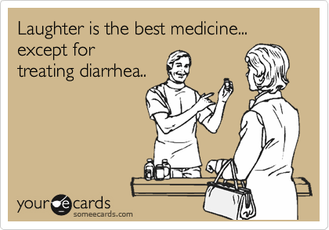

Slide 41
Names of Medications
Brand vs generic
MANY different prescription medications in the US

Slide 42
Names of medications
How are medications named?
  All medications have two names
    brand (trade) name: chosen by the drug manufacturer & picked to be simple or memorable. Brand names are Capitalized
    generic name: generally derived from the chemical structure of the drug. The generic name is lower case
    Two VERY different medications can have very similar generic names (fluoxetine & fluvoxamine is one example) –
    Read carefully!

Slide 43
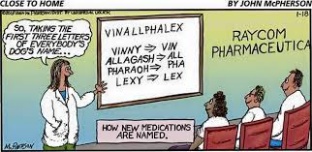

Slide 44
Names of medications
There are over 20,000 prescription medications approved by the Food and Drug Administration (FDA) in the US
There can be more than one brand name of a given medication
It is beyond the scope of this course to teach more than the very basics about medications you may encounter
Read or ask about medications that are new to you to learn why they are given, what side effects are common, and more

Slide 45
Proper medication storage
Securely
Safely

Slide 46
Medication Storage
Medications should be secured so they cannot be tampered with or accidentally eaten
Refrigerated medications should have safeguards, such as locked boxes or drawers
Medications should be kept in the original container (or med pack) with original labeling
Topical medications should be stored separately from other medications
Each person should have his/her own compartment, bin, or area for their own medications
Are to be used ONLY by the person for whom they are prescribed
Are not be used after the expiration date
Dispose of medications according to your agency’s policy

Slide 47
How to give medications (administration)
Universal Precautions
Medical abbreviations
Measurements
6 Rights of Administration

Slide 48
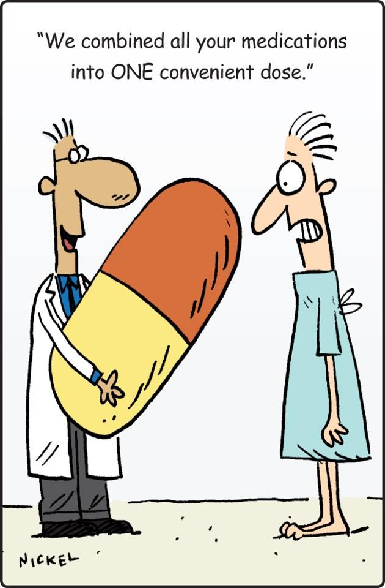

Slide 49
Universal precautions
Wash hands with soap and water or use hand sanitizer before and after giving patient medications
Wear gloves when handling medications
Wipe down the area you use to prepare medications with a cleaner or disinfectant before use
Cough into your elbow
Throw away medications that fall on the floor or other unclean surface and ask a nurse or supervisor how to get a replacement

Slide 50
Abbreviations
Commonly used abbreviations for prescriptions:
  AM = morning
  cc = cubic centimeter = ml
  ml = milliliter
  h or hr = hour
  Hs or HS = at bedtime
  PM = afternoon; evening
  po = by mouth
  PRN = when needed
  sup or supp = suppository
  tab = tablet
  Tbsp = tablespoonful
  tsp = teaspoonful
  mg = milligram
  BID = two times a day
  TID = three times a day
  QID = four times a day

Slide 51
Measurement
Common metric measurements you should know:
  Most capsules and tablets are in milligrams (mg)
  1000 mg = 1 gram
  500 mg = 0.5 grams
  250 mg = 0.25 grams
  100 mg = 0.1 grams

Slide 52
Measurement, cont…
Quantities given
You have Dilantin 100 mg capsules. John needs 400mg to be taken at bedtime.
  Give John four 100 mg capsules = 400 mg
You need a dose of 1 gram of Tylenol. You only have 500 mg (0.5 gram) tablets
  Give two 500 mg tables = 1000 mg = 1 gram

Slide 53

Liquid Medication
When preparing an oral liquid dose of medication, caregiver holds the measure at eye level, with thumbnail resting on the line that marks the level to which liquid should be poured.
Note: injected medications (e.g. insulin) are ONLY allowed to be given by licensed nurses and CANNOT be delegated.
Liquid Measurement (volume)
  1 ml = 1 cc
  2 ½ ml = ½ teaspoon (tsp)
  5 ml = 1 teaspoon (tsp)
  15 ml = 3 teaspoons (tsp)
  15 ml = 1 Tablespoon (Tbsp)
  30 ml = 1 fluid ounce (oz)

Slide 54
Liquid Measures
Most liquids are measured in milliliters (ml) or liters (L)
5ml = 5cc = 1 teaspoonful (tsp)
15ml = 15cc = 1 tablespoon (Tbsp)
30ml = 30cc = 1 ounce (oz)
240ml = 240cc = 8 ounces (oz) = 1 cup (c)
One ml is 1/1000th of a liter, and a cc is one cubic centimeter. Both are equivalent measures of volume

Slide 55
Strength of Liquid Meds
The strength of liquid medicine is measured in mg/ml
Medications often are available in multiple strengths. For example, amoxicillin comes in 125 mg, 200 mg, 250 mg, or 400mg per 5 ml of liquid suspension
Sometimes medications are the same strength but different numbers.
For example, both orders below are the same strength.
  Order #1 - amoxicillin 500 mg per 10 ml of suspension
  Order #2 - give 10ml of amoxicillin 250 mg per 5 ml
Read carefully and double check!

Slide 56
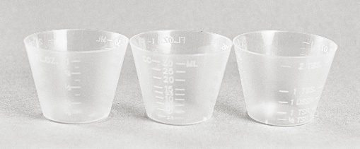
Strength of Liquid Meds, cont..
Example:
Your directions say to give 1 Tablespoon of cough syrup, every 4 hours, as needed for cough
Do NOT use an eating utensil like a soup spoon to measure medications. They are not accurate
Use a metric measuring device
You would give 15 ml because this equals 1 tablespoonful

Slide 57
Using Drops or Ointments
Wash hands thoroughly with soap & water
Put on clean, new, non-latex gloves
Check dropper top to make sure it is not chipped or cracked
Avoid touching the dropper on the eyelid or eye lashes or anything else—eye droppers and tubes must be kept clean
While tilting head back, pull down lower lid of eye with an index finger to form a pocket
If possible, have the client pull down their eyelid

Slide 58
Using Drops or Ointments, cont…
With the other hand, hold dropper tip as close to the eye as possible without touching it
Brace the remaining fingers of the hand against the face
Gently squeeze the dropper so that the correct number of drops fall into the pocket made by the lower eyelid
Close the eye for 2 minutes. Wipe away any excess with tissue
Replace and tighten the cap right away. Do not wipe or rinse the dropper tip
Remove gloves and wash hands

Slide 59
6 Rights of Administration
Important: 6 Rights of Medication Administration
  The Right Person
  The Right Medication
  The Right Dose
  The Right Route
  The Right Time
  The Right Documentation

Slide 60
The Rights…
The Right Person:
  Always look on the medication label & Medication Administration Record (MAR) to make sure the name matches the person
  Medications are to be used ONLY for the person whose name is on the label
The Right Medication:
  The medication must be the one prescribed by the person’s healthcare provider
  Many medication names sound alike but are VERY different
  There can be several names for the same medication; generic, trade
The Right Dose:
  The correct dose will be documented on the prescription label
  Multiple tablets or measuring liquids may need to happen to give the correct dose
  Abbreviations & measurements may be used & will be discussed later

Slide 61
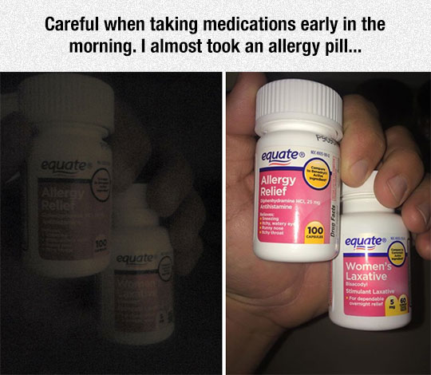

Slide 62
The Rights…
The Right Route:
  This is the method with which it is given: oral (swallowed), ophthalmic (eye), otic (ear), inhaled, rectal, vaginal, or topical (patches, cream, ointment)
The Right Time:
  Medications & Treatments must be given within 1 hour before, or 1 hour after the scheduled time
  Some medications are given at multiple times during the day
  Some medications are ordered for once a day or on different days of the week
  Most medications are ordered on a specific time schedule
  Some medications are ordered to be given “as needed” or “PRN”
  Before giving a “PRN” medication you must:
    Have written instructions which includes the dosage, how often, and how long (or how many times) and when to contact the Nurse

Slide 63
The Rights…
The Right Documentation:
  The Medication Administration Record (MAR) is used to document the administration of all medications
  After the medication is given, your initials are written in the correct box to note the time it was given. You might enter that information in the software on your computer, tablet, or phone
  If the medication is NOT given, circle your initials and document in the record why it was not given
  Whatever system is used, the purpose of documentation is to accurately and completely record the care given to individuals
  Documentation is CRUCIAL. It is a permanent record and a legal one.
  A familiar phrase in healthcare is “If it wasn’t documented, it wasn’t done.”
  Documentation must be complete and legible
  Draw a single line through an erroneous entry to identify it as an error

Slide 64
The Rights…
Note: when a medication comes into the home, make sure it is the SAME strength as the order! If it is different, contact the pharmacy

Slide 65
Medication Don’ts
The “Don’ts” of Medication Administration
  Don’t administer medications that aren’t filled by a pharmacy or a healthcare provider with an original label
  Don’t administer one person’s medication to another person
  Don’t double up on a missed dose unless instructed to by the primary care provider
  Don’t cut or crush an un-scored pill without orders from a pharmacist or healthcare provider
  Don’t document until you give the medication
  Don’t try to hide your mistakes
  Don’t ask another person to perform the task you are responsible for doing
  Medication administration is a serious responsibility and may not be transferred

Slide 66
Recording given medications (documentation)

Slide 67
Documentation
ALL prescription and non-prescription (over-the-counter) medications, including vitamins or herbs, must be approved by the healthcare provider
Each medication must be on the Medication Administration Record (MAR) with complete instructions for how to give them. If information is missing, contact the healthcare provider for clarification
This includes:
  name of the medication (or supplement)
  strength of the medication
  quantity of the medication
  how to give the medication (by mouth, rub on skin, etc.)
  when to give the medication

Slide 68
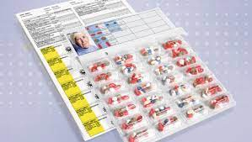
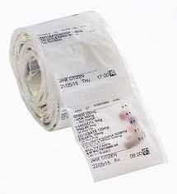
Packaging & Delivery
  Med packs or sets
    May come in blister packs, rolls, or sachets
    Contain medications for an entire week or month
    Clear plastic on the front of the package to allow for inspection of the medications by the caregiver without opening first

Slide 69
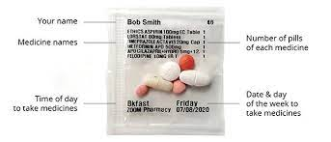
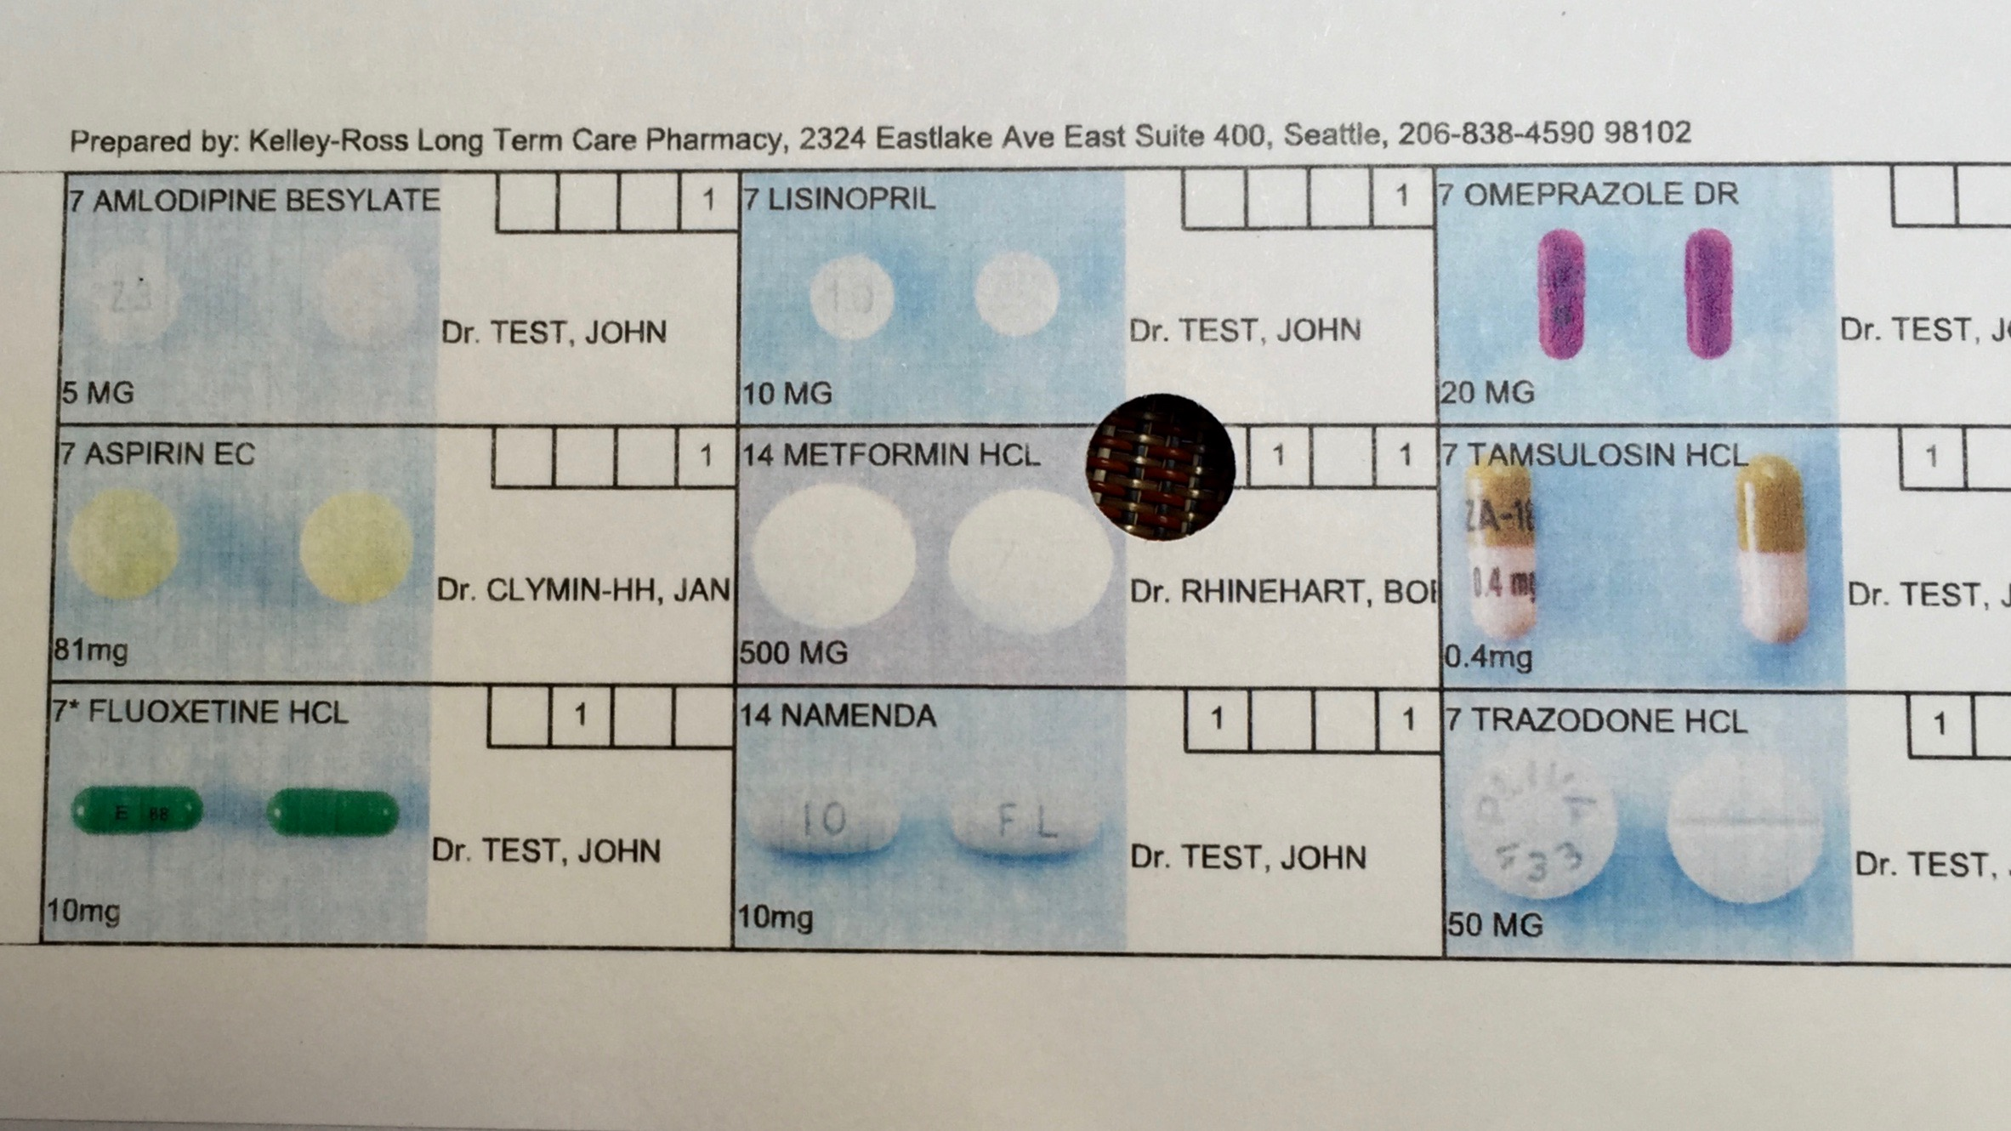
Packaging & Delivery
  Med packs or sets labeling:
    Name of person getting medication
    Name of medication(s)
    Quantity of each medication
    Time of day to give
    Day and date to give
    Might include pill pictures or descriptions

Slide 70
Packaging, cont…
  Pharmacy bottles
    Contains one type of medication
    Enough for 1 to 3 months
    May be liquid, tablet, capsule
  Pharmacy bottle labels
    Individual’s name
    Name and strength of medication
    Directions
    Number of capsules/tablets
    Number of refills
    Prescription number
    Name of prescriber

Slide 71
Where Can I Get More Information?
Attention
Medication manufacturer’s medication insert
The agency nurse or nurse practitioner
The pharmacist
The healthcare provider prescribing the med
Warning: this is a general medication administration training module. Each caregiver must be trained by the nurse who is delegating you to administer medications on each individual’s medications before administering medications.

Slide 72
Alaska Assisted Living Homes Resident Bill of Rights http://dhss.alaska.gov/dhcs/Documents/Residential-Licensing-Background/Sample-Forms/Notice-of-Resident%27s-Rights.pdf

Slide 73
Residents of Alaska Assisted Living Homes Rights
a. live in a safe and sanitary environment;
b. be treated with consideration and respect for personal dignity, individuality, and the need for privacy, including privacy in
  1. medical examination or health-related consultation;
  2. the resident’s room or portion of a room;
  3. bathing and toileting, except for any assistance in those activities that are specified in the resident’s assisted living plan; and
  4. the maintenance of personal possessions and the right to keep at least one cabinet or drawer locked;
c. possess and use personal clothing and other personal property, unless the home can demonstrate that the possession or use of certain personal property would be unsafe or an infringement of the rights of other residents;

Slide 74
Residents of Alaska Assisted Living Homes Rights…
d. engage in private communications, including
  1. receiving and sending unopened correspondence;
  2. having access to a telephone, or having a private telephone at the resident’s own expense; and
  3. visiting with persons of the resident’s choice, subject to the visiting hours established by the home;
e. close the door of the resident’s room at any time, including during visits in the room guests or other residents;
f. at the resident’s own expense unless otherwise provided in the residential services, participate in and benefit from community services and activities to achieve the highest possible level of independence, autonomy, and interaction with the community;
g. manage the resident’s own money;
h. participate in the development of the resident’s assisted living plan;

Slide 75
Residents of Alaska Assisted Living Homes Rights…
i. share a room with a spouse if both are residents of the home;
j. have a reasonable opportunity to exercise and to go outdoors at regular and frequent intervals when weather permits;
k. exercise civil and religious beliefs;
l. have access to adequate and appropriate health care and health care providers of the residents own choosing, consistent with established and recognized standards within the community;
m. self-administer the resident’s own medications, unless specifically provided otherwise in the resident’s assisted living plan;
n. receive meals that are consistent with religious or health-related restrictions;
o. receive the prior notice of the home or the home’s intent to terminate the services contract of the
p. present to the home grievances and recommendations for change in the policies, procedures, or services of the home;

Slide 76
Residents of Alaska Assisted Living Homes Rights…
q. at the resident’s own expense unless otherwise provided in the residential services contract, have access to and participate in advocacy or special interest groups;
r. at the resident’s own expense unless otherwise provided in the residential services contract, intervene or participate in, or refrain from participating in, adjudicatory proceedings held under this chapter, unless provided otherwise by other law;
s. reasonable access to home files relating to the resident, subject to the constitutional right of privacy of other residents of the home;
t. visits from advocates and representatives of community legal services programs, subject to the resident’s consent for the purpose of
  1. making personal, social, and legal services available;
  2. distributing educational and informational materials to advise a resident or resident’s representative of applicable rights; and
  3. assisting a resident or resident’s representative in asserting legal rights or claims;
u. immunity from civil liability for the filing a complaint concerning a violation under AS 47.33 or 7 AAC 75 or testifying in an administrative or judicial proceeding arising from a complaint concerning a suspected violation, unless the person acted in bad faith or with malicious purpose.

Slide 77
What to do when mistakes are made (medication errors)

Slide 78
Medication errors
A medication error is any time that:
  The right medication is not administered
  Or to the right person
  Or at the right time
  Or in the right amount
  Or by the right route
  Or if it is not documented correctly

Slide 79
Medication errors…
Remember – you are human and humans make mistakes
Don’t make it worse by hiding your mistake
Do what you would want someone to do if you or your family member was the one who took the wrong medication

Slide 80
Medication errors…
Steps to take if a medication error occurs:
  Check the level of consciousness & breathing of the person first
  If there are breathing problems, seizures, or difficulty arousing the person, Call 9-1-1
  Call the nurse on duty or your supervisor
  Call the healthcare provider who prescribed the medication
  If the provider does not respond within 1 hour, call the emergency room for guidance
  Document the error and steps you took after

Slide 81
How to protect privacy (confidentiality)

Slide 82
Confidentiality
A person’s illnesses & medications are private matters
Under HIPAA, you may talk to healthcare professionals (RNs, LPNs) where you work about a person’s medications, but only to perform your job.
A caregiver must be aware of this responsibility and never discuss any matter pertaining to health or medications with any person not involved in the care of the patient, unless you have the specific written consent of the person or his/her guardian.

Slide 83
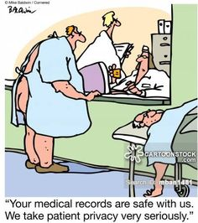

Slide 84
What if I am not sure what to do??
As a person caring for or providing support for an individual, YOU are responsible for that person
If you have ANY concern about the person you are supporting or their medication, contact:
the nurse, your supervisor, their pharmacist, or their PCP.
Call 911 for a serious emergency

Slide 85
Sources for Medication Information
  PDR: Physicians Desk Reference
  Nursing drug references
  www.drugs.com
  Pharmacy where the prescriptions were filled
  Patient’s primary care provider

Slide 86
The Internet…
Anyone can post information on the Internet
This information is NOT always correct!
Some people will post inaccurate information about medications and treatments
Read information from the drug manufacturer or reputable online source
www.drugs.com
www.everydayhealth.com/drugs/
www.mayoclinic.org/drugs-supplements
www.webmd.com/drugs/2/index

Slide 87
In Summary
To ensure quality care and the safety and well-being of every individual, each caregiver must be competent and knowledgeable
The caregiver must know about the individual and their ordered medications
The caregiver should be knowledgeable about how to safely administer medications and the policies of their organization
The caregiver is expected to know when to ask for help and when to report problems

Slide 88
This PowerPoint was edited and recreated from the Alaska Board of Nursing website document by Nancy Edtl, MBA, RN, BSN, NCSN; director of Nursing & Health Services, Anchorage School District. November 2012. Updated January 2022 by Ivan Wang, MS, PA-C, Alaska Pioneer Homes.

